Slide 1
Module 7:
SAE & Work Experience

Slide 2
Module Objectives
Identify soft skills associated with SAEs and work experiences
Describe the road map of an SAE
Describe effective Foundational and Immersion SAEs
Describe how to incentivize students to participate in SAEs

Slide 3
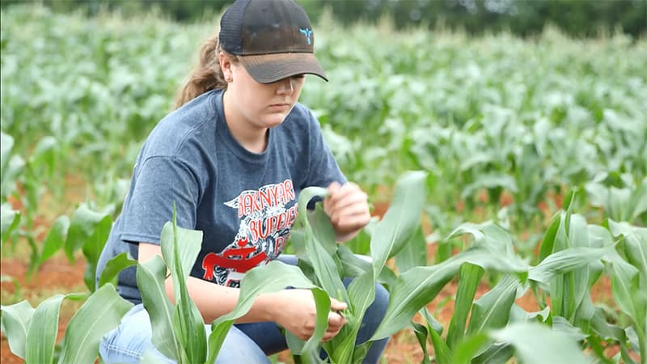
Philosophy
Supervised Agricultural Experiences provide an outlet for students to use classroom knowledge into real-world applications. By doing so, students enhance their technical, employability, and soft skills.

Slide 4
Standards
Achievement Motivation
Time Management
Active Initiative
Likes to initiate action in new situations.
Makes optimum use of time.
Motivated to achieve excellence and put the required effort into action to attain it.
CRP.02 Apply appropriate technical skills.
CRP.03 Attend to personal health and financial well-being.
CRP.06 Demonstrate creativity and innovation.
CRP.08 Utilize critical thinking to make sense of problems and persevere in solving them.
CRP.11 Use technology to enhance productivity.
Career Readiness Practices
Notes:
Morgan icons needed

Slide 5
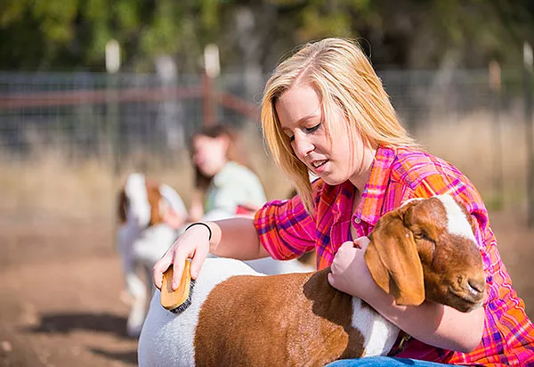
SAEs of Today
Student-led
Instructor Supervised
Work-based
Measurable Outcomes
Notes:
Beyond traditional SAE’s
Diversity of students, chapter resources, and school geography
Student-led, instructor supervised, work-based learning experience that results in measurable outcomes within a predefined, agreed upon set of Agriculture, Food and Natural Resources(AFNR) Technical Standards and Career Ready Practices aligned to a career plan of study.

Slide 6
SAE Roadmap
Enroll in Agricultural Education
Choose an Immersion SAE
College and Career Ready
Grow
1
3
5
7
2
4
6
Launch Foundational SAE
Get Coaching and Feedback
Enjoy the Benefits

Slide 7
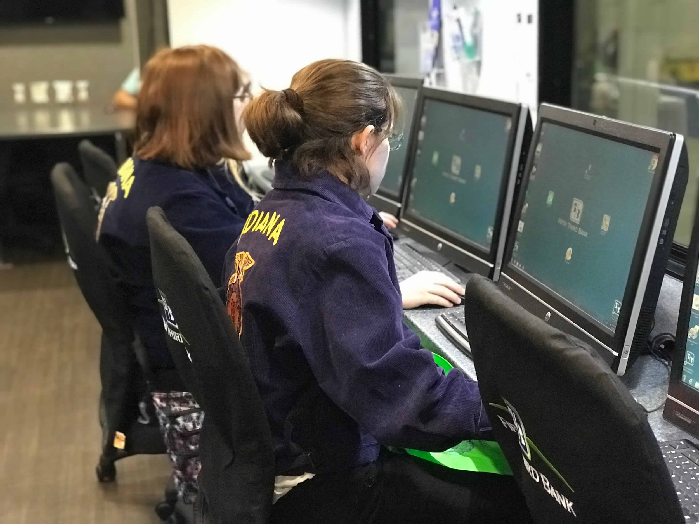
Foundational SAEs
Career Exploration and Planning
Employability Skills for College and Career
Personal Financial Management and Planning

Slide 8
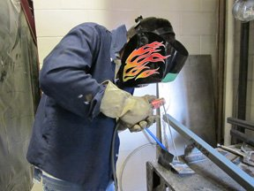
Foundational SAEs
Workplace Safety
Agriculture Literacy

Slide 9
SAE Roadmap
Enroll in Agricultural Education
Choose an Immersion SAE
College and Career Ready
Grow
1
3
5
7
2
4
6
Launch Foundational SAE
Get Coaching and Feedback
Enjoy the Benefits

Slide 10
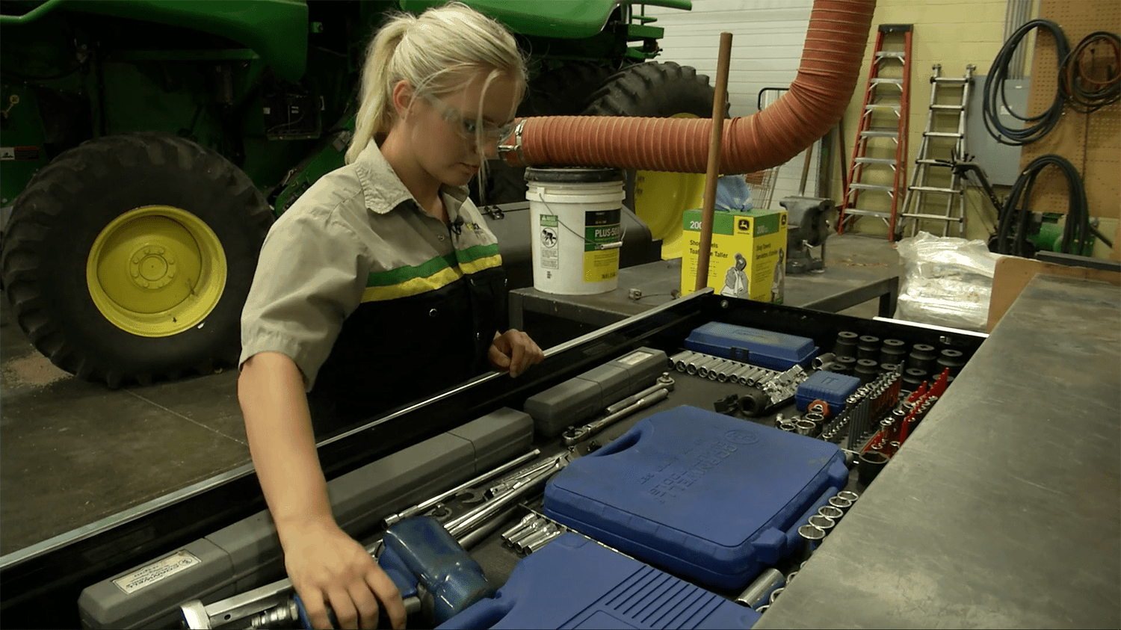
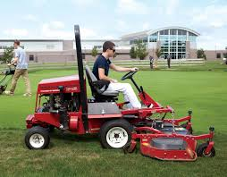
Immersion SAEs
Placement/Internship
Ownership/
Entrepreneurship
Research

Slide 11
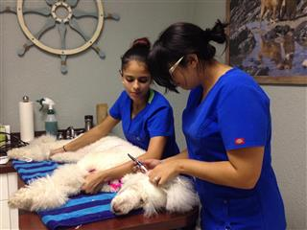
Immersion SAEs
School-Based Enterprise
Service Learning

Slide 12
SAE Roadmap
Enroll in Agricultural Education
Choose an Immersion SAE
College and Career Ready
Grow
1
3
5
7
2
4
6
Launch Foundational SAE
Get Coaching and Feedback
Enjoy the Benefits

Slide 13
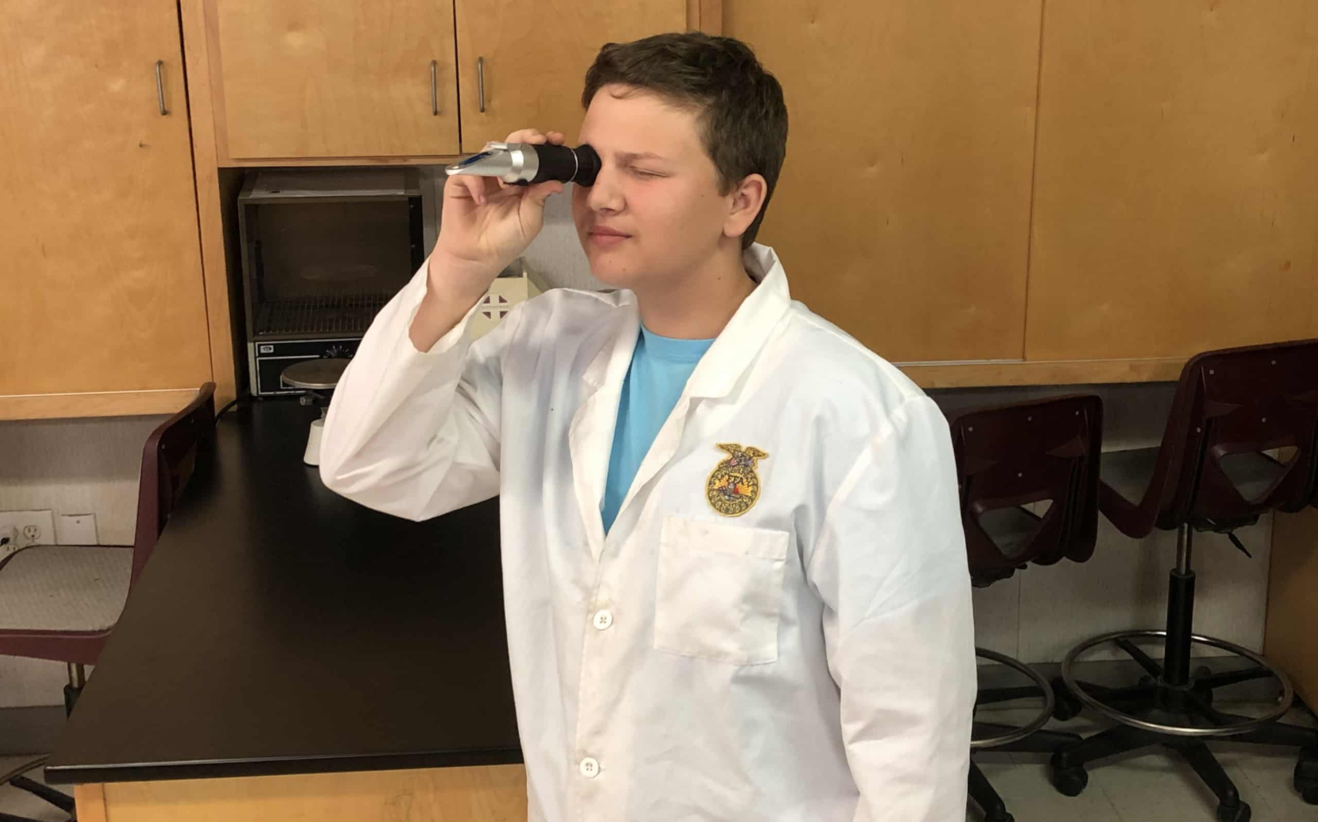
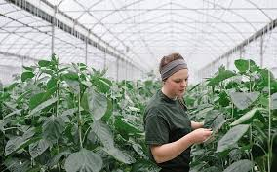
Effectively Engaging Students
Make SAEs a graded component of every class
“What’s In It For Me?” (WIIFM)
Career Exploration as the First Foundational SAE Activity

Slide 14
Big Idea
Foundational & Immersion SAE’s
Effective Engagements
Skills Gained
Technical Skills
Time Management
Achievement Motivation
Active Initiative
College and Career Ready

Slide 15
Chapter Spotlight:
Clovis East FFA

